Slide 1
Netflix Dataset Analysis
File created on: 12/21/2022 3:37:58 PM

Slide 2
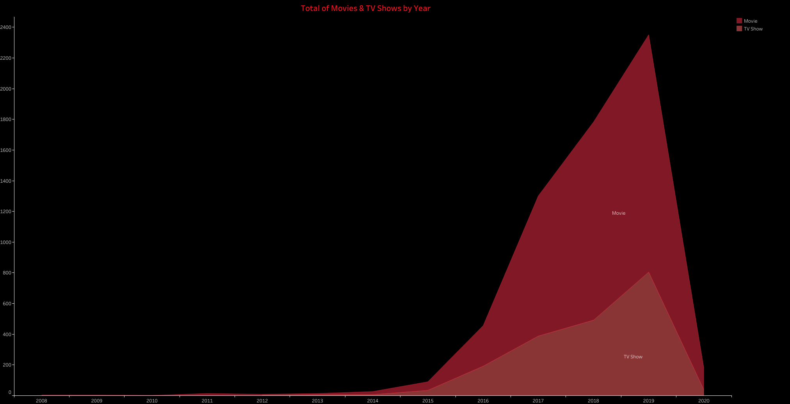

Slide 3
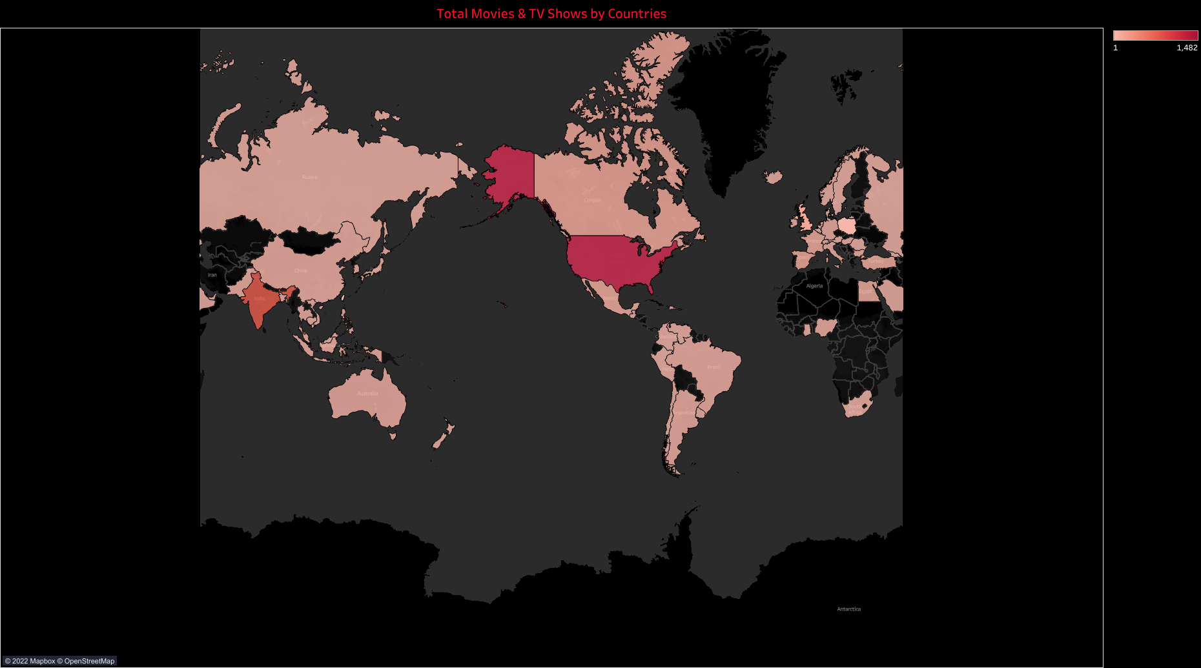

Slide 4
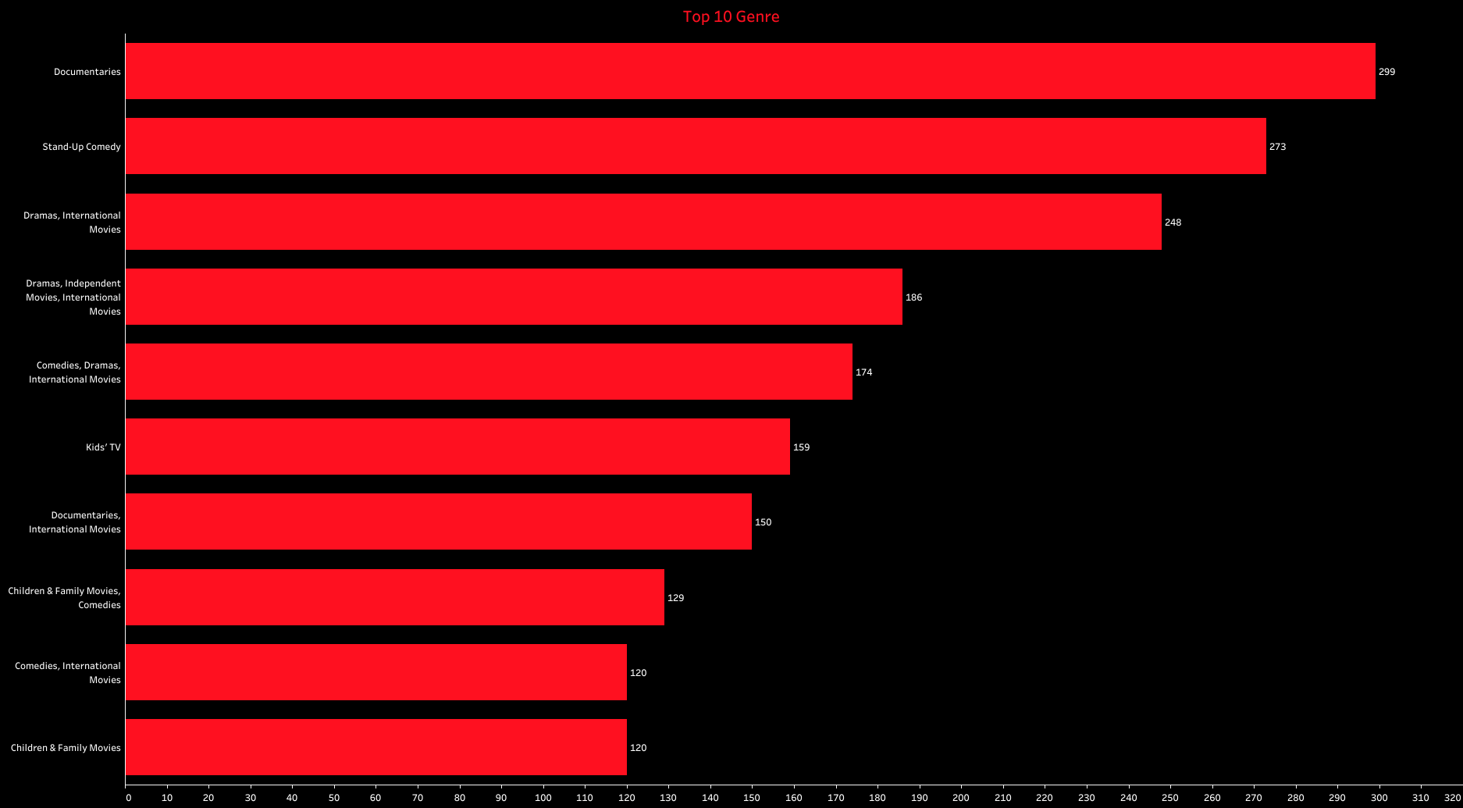

Slide 5
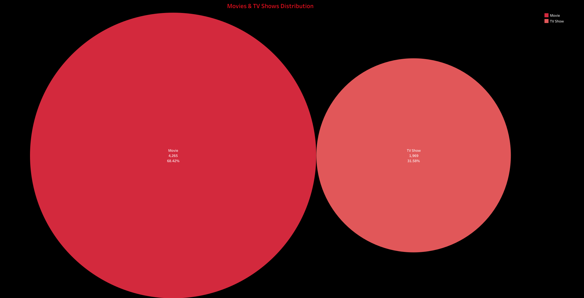

Slide 6
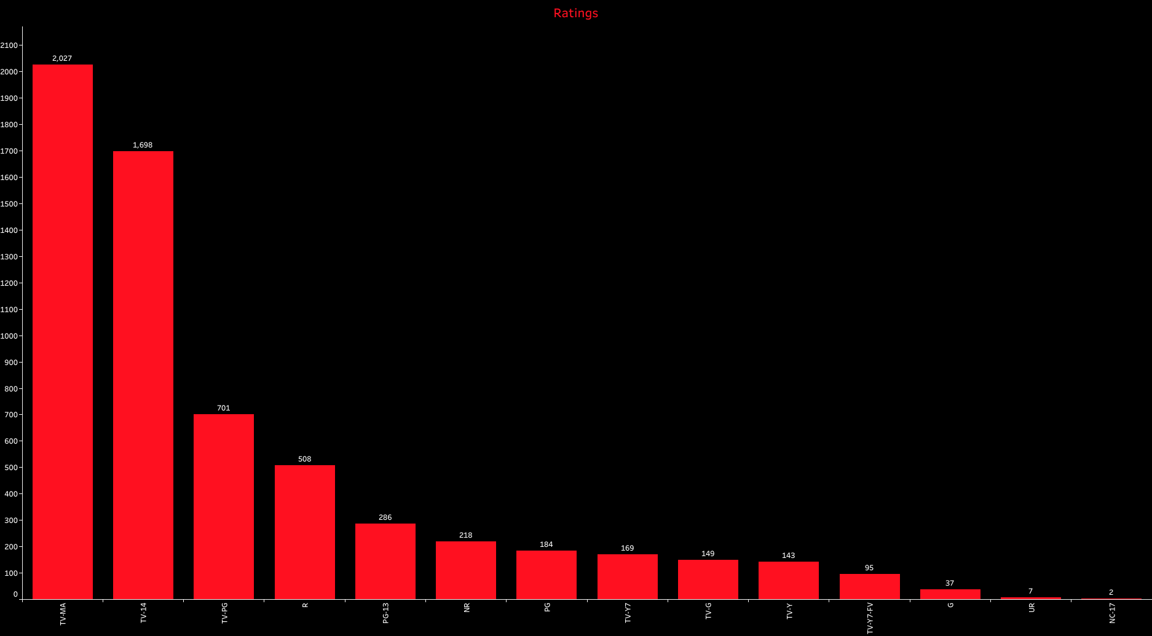

Slide 7
